Slide 1
KG foundation models

Slide 2
Overview
What is a foundation model?
Knowledge graph (KG) review
Standard KG completion models fail as KG foundation models
Relational GNNs mostly fail as KG foundation models
InGram – a conditional KG foundation model

Slide 3
What is a foundation model?

Slide 4
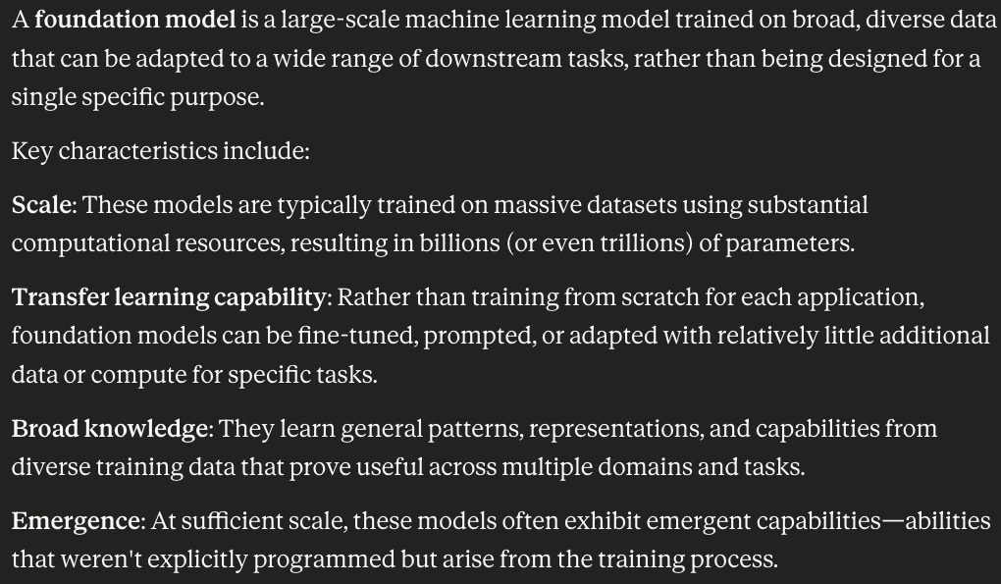
What is a foundation model?
If you ask your favorite LLM, you’ll get something like:

Slide 5
What is a foundation model?
Subjective terms describing implementation details that are likely to change over time (remember big data?)
If you ask your favorite LLM, you’ll get something like:
Isn’t this just transfer learning?

Slide 6
What is a foundation model?
An alternative definition:
A foundation model is a machine learning model that exhibits sufficient task diversity and generalization that it can perform tasks with different formal structures from its training objective, making zero-shot or few-shot application the reasonable first approach for novel problems.

Slide 7
What is a foundation model?
An alternative definition:
A foundation model is a machine learning model that exhibits sufficient task diversity and generalization that it can perform tasks with different formal structures from its training objective, making zero-shot or few-shot application the reasonable first approach for novel problems.
Task diversity – performing a task with the same formal definition in different domains (e.g., sentiment analysis on movies vs. product reviews)

Slide 8
What is a foundation model?
An alternative definition:
A foundation model is a machine learning model that exhibits sufficient task diversity and generalization that it can perform tasks with different formal structures from its training objective, making zero-shot or few-shot application the reasonable first approach for novel problems.
Task diversity – performing a task with the same formal definition in different domains (e.g., sentiment analysis on movies vs. product reviews)
Task generalization – performing a task with a different formal definition which typically includes different evaluation criteria (e.g., next token prediction vs. question answering)

Slide 9
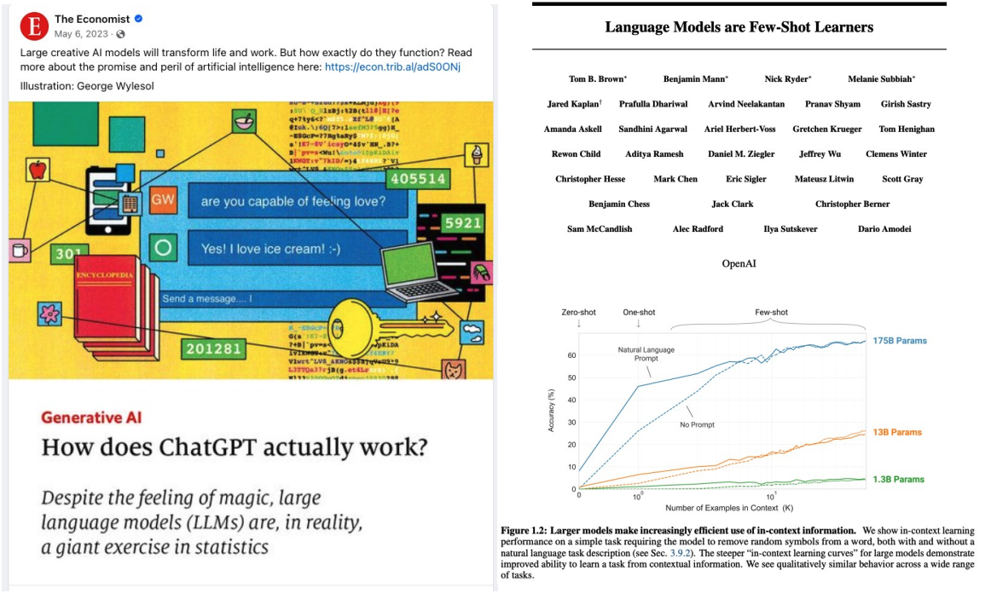
Large language models (LLMs)

Slide 10
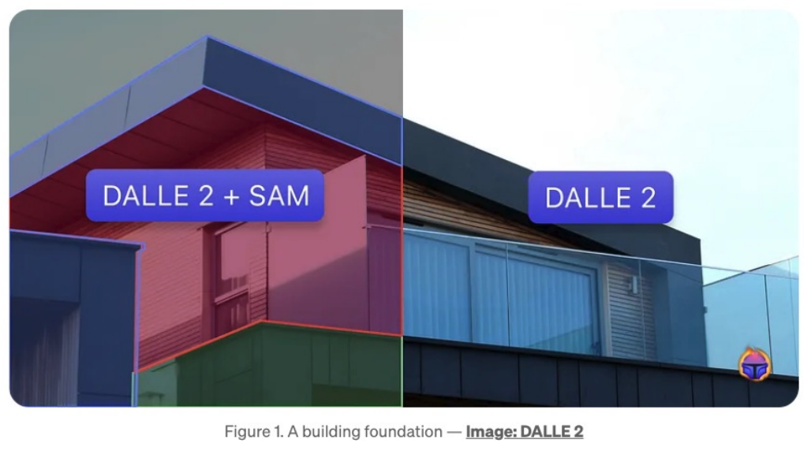
Computer vision models

Slide 11
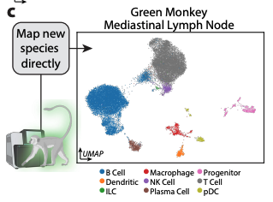
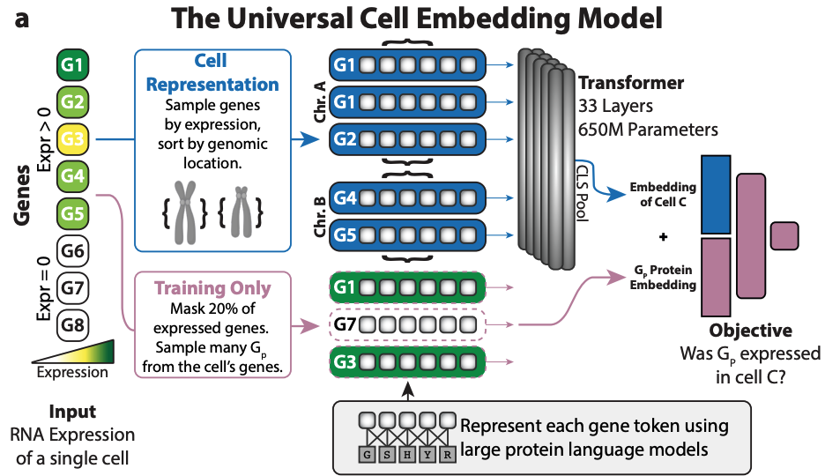
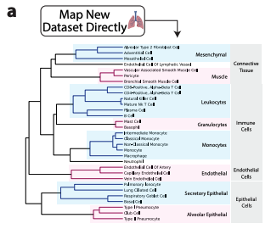
Cell biology models
Image credit: Rosen et al., 2023, bioRxiv

Slide 12
Today’s foundation models
Pretrained using self-supervision with large amounts of data
Capable of zero-shot or few-shot learning on tasks that differ from pre-training
Generalize to entities (domains) not observed during training

Slide 13
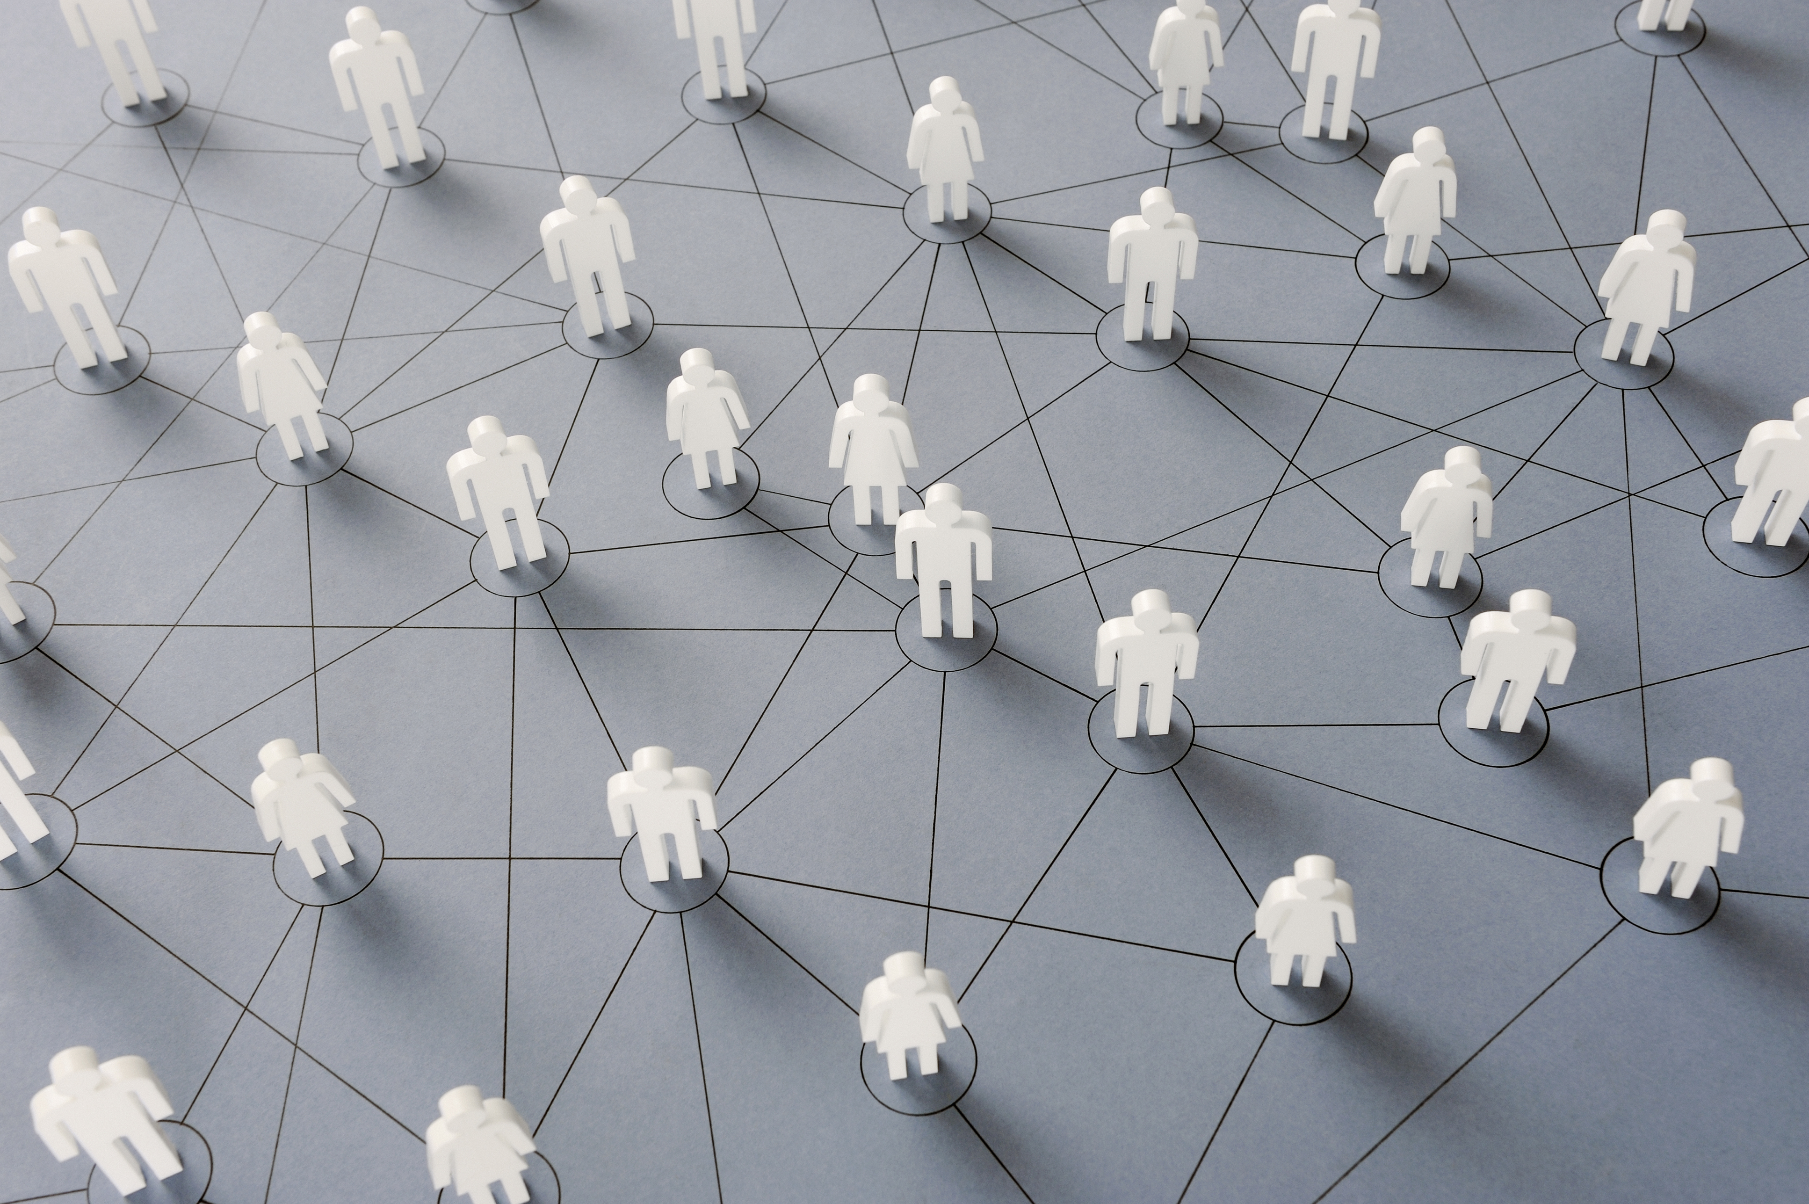
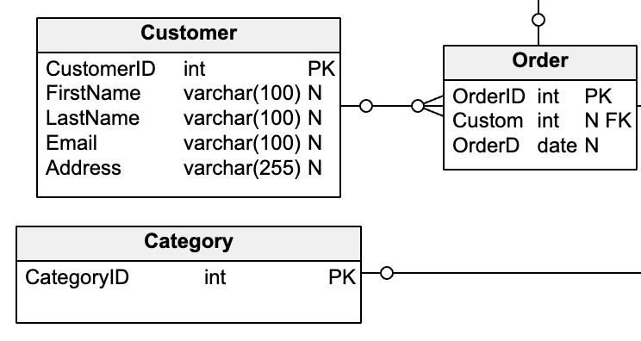

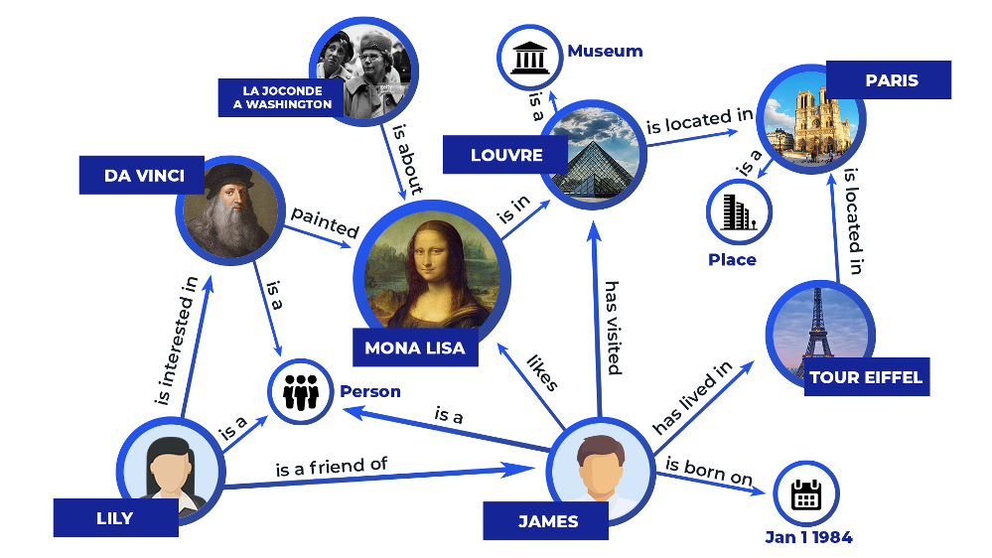
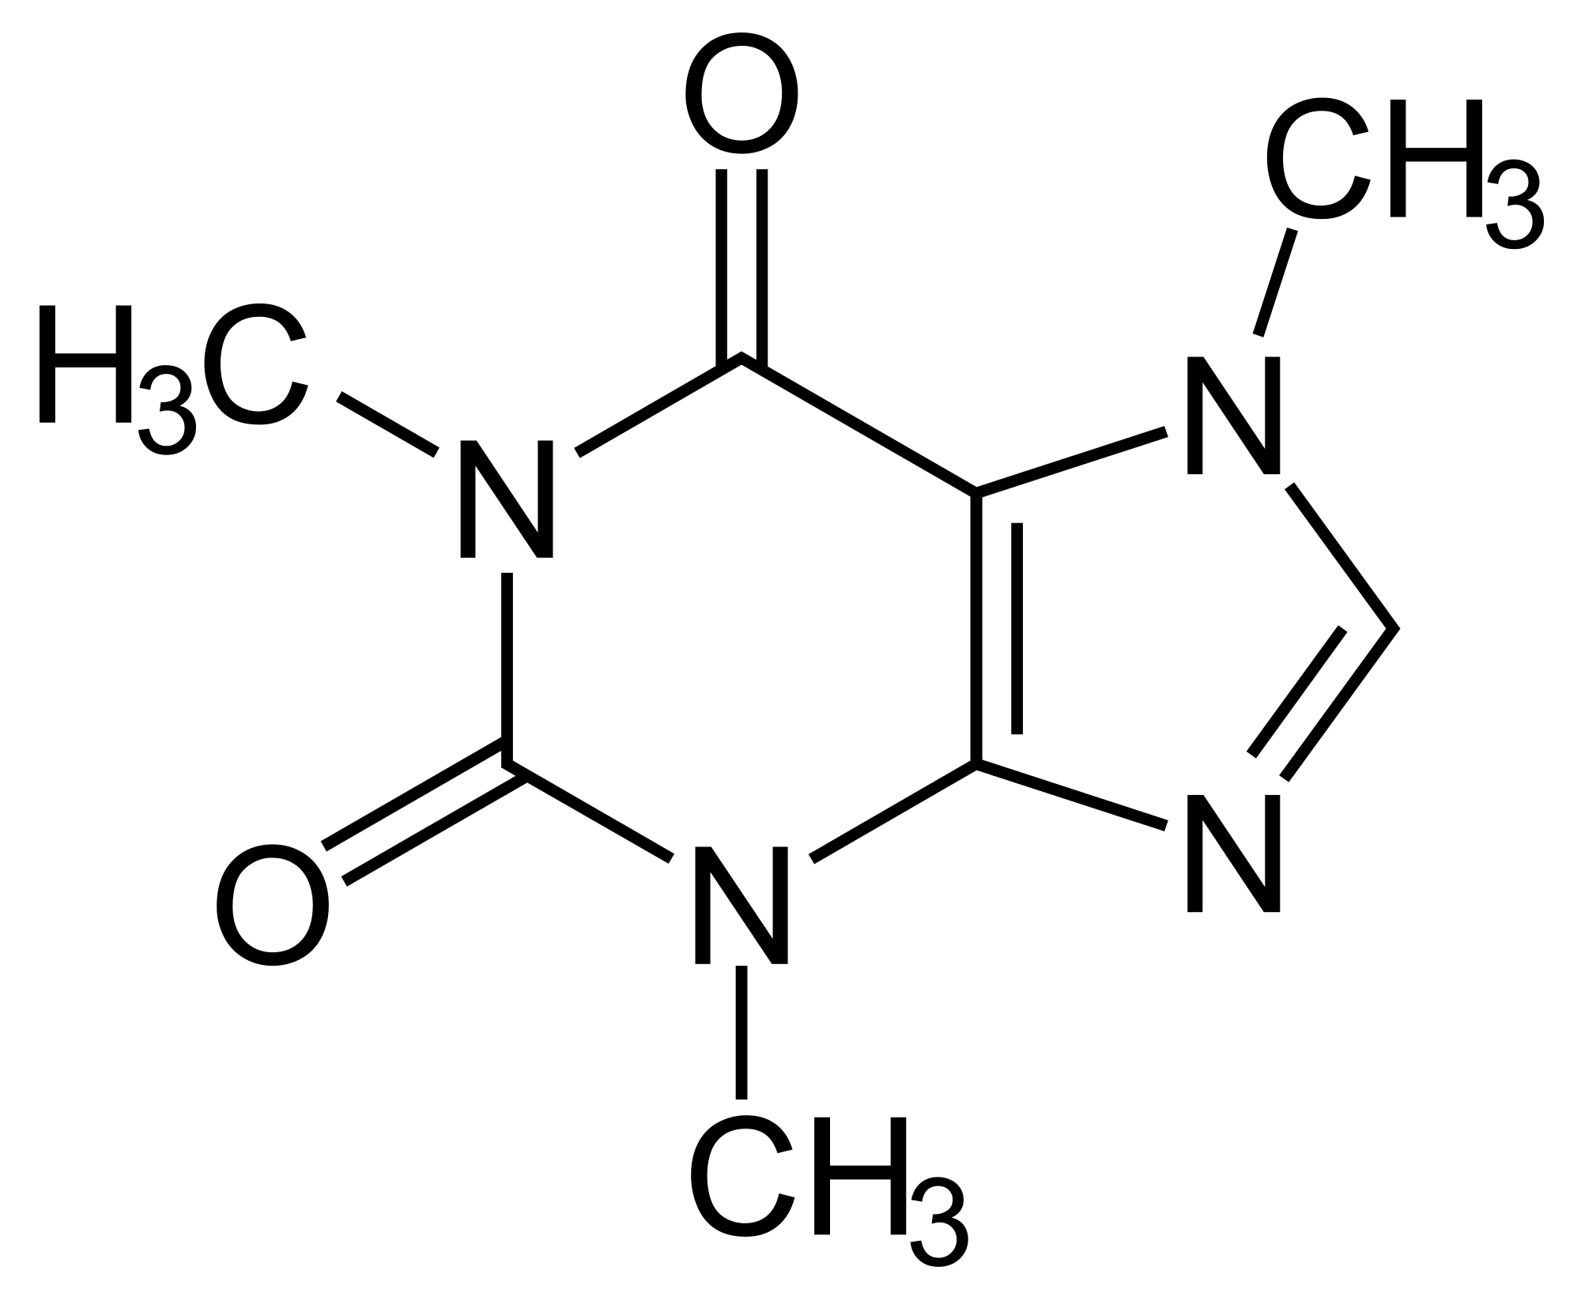
Graph foundation models?
Many types of graphs with different structures, semantics, and feature data
Many tasks in different domains
Image credit: vertabelo
Image credit: Chemistry StackExchange
Image credit: Zilliz

Slide 14
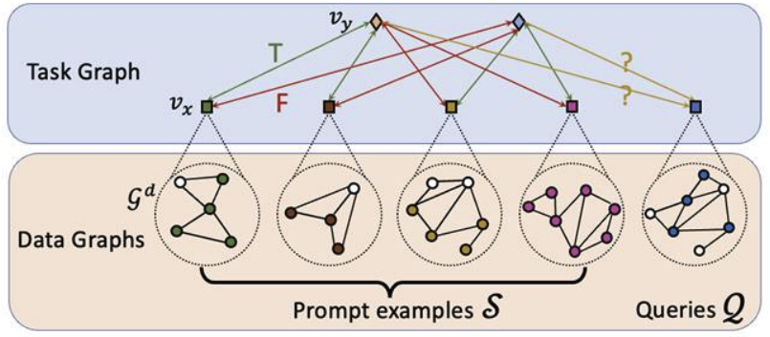
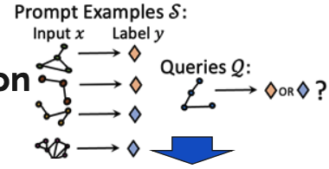
PRODIGY – a step toward graph foundation models
Unified framework for few-shot classification learning on graphs
Agnostic to graph type
Constraints
Requires data graph nodes to have input features → node features must be represented in the same feature space (e.g., text embedding)
Requires retraining in different domains where node features are not represented with text or text is out of sample from training data
Image credit: Huang et all, 2023, NeurIPS

Slide 15
Knowledge graph review

Slide 16
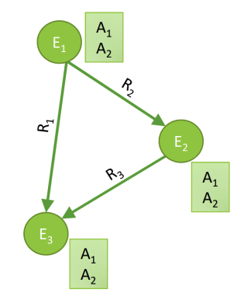
Knowledge graphs
Heterogeneous graphs that represent entities, types, and relationships
Nodes are entities
Nodes are labeled with their types
Nodes do not have features
Edges between nodes indicate specific relationships between entities, often directional
Typically represented by triples (head, relation, tail) where head (h) has relation (r) with tail (t)
Image credit: Jure Leskovec, http://cs224w.stanford.edu

Slide 17
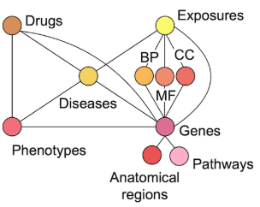
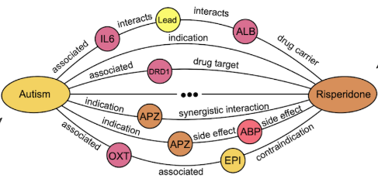
Biomedical knowledge graphs
Node types: drugs, biological pathways, diseases, …
Relation types: associated, interacts, …

Slide 18
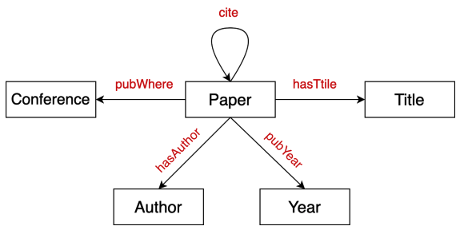
Bibliographic networks
Node types: paper, title, author, conference, year
Relation types: pubWhere, pubYear, hasTitle, hasAuthor, cite
Image credit: Jure Leskovec, http://cs224w.stanford.edu

Slide 19
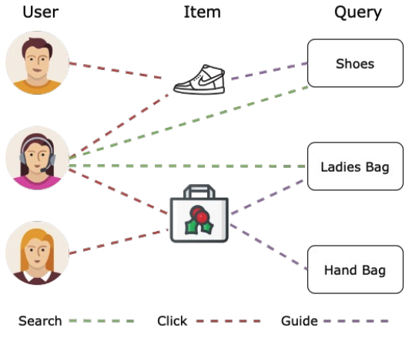
E-commerce graph
Node types: user, item, query, location
Relation types: purchase, visit, guide, search
Image credit: Jure Leskovec, http://cs224w.stanford.edu

Slide 20
KG vs natural language foundation models
E-commerce graph example
Natural language:
User searches for shoes. User buys hand-bag.
All entities are of the same type (words / tokens)
Knowledge graph:
User, Shoes, Hand-bag → entities
Searches, Buys → relations
Two modalities, heterogeneous constructs requiring different “interpretation”

Slide 21
KG vs natural language foundation models
E-commerce graph example
Natural language:
User searches for shoes. User buys hand-bag.
Tokens are connected sequentially
Knowledge graph:
Entities are connected in an arbitrary graph structure that is informative
Image credit: Jure Leskovec, http://cs224w.stanford.edu

Slide 22
Toward foundation models for knowledge graphs
KG foundation model should be able to form embeddings for new entities and relations in any KG
Double equivariant architecture – node and edge relabeling only permutes their respective embedding order
Without edge equivariance, model learns “The relation called employs connects organization to employee, and the relation co-worker connects employees”.
With edge equivariance, model learns relations that connect high-degree nodes to medium-degree nodes which are also connected via a symmetric relation are antisymmetric
How? One approach
Process the graph structure between entities using GNNs
Use KG completion as a self-supervised learning task

Slide 23
Standard KG completion models fail

Slide 24
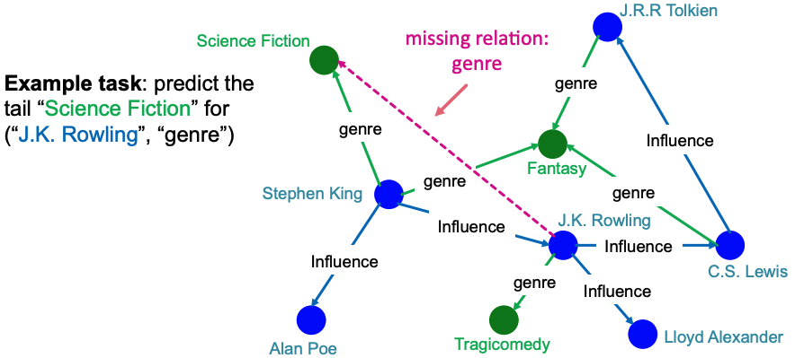
Knowledge graph (KG) completion task
Given a large KG, can we ”complete” it (i.e., add missing edges)
Task is typically formulated as predicting tails (or consequents)
Given (head, relation) predict missing tails
Image credit: Jure Leskovec, http://cs224w.stanford.edu

Slide 25
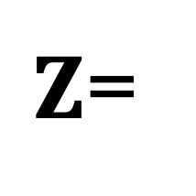
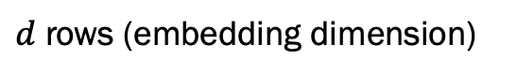
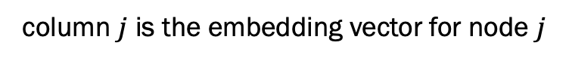
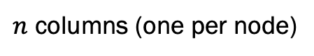
Transductive methods for KG completion
“Standard” KG completion methods use shallow embedding methods for computational efficiency on large KGs
column $j$ is the embedding vector for node $j$
$Z$=
$d$ rows (embedding dimension)
embedding
matrix
$n$ columns (one per node)

Slide 26
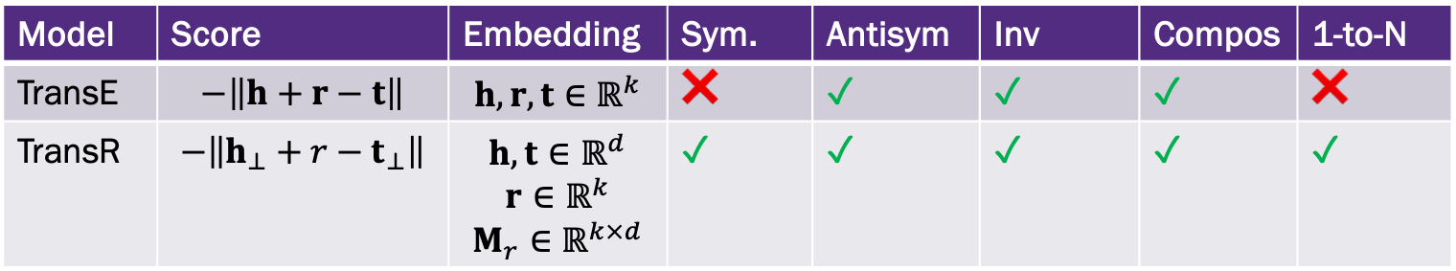
KG Completion Models
Model | Score | Embedding | Sym. | Antisym | Inv | Compos | 1-to-N
TransE | $$−\left\|h+r−t\right\|$$ | $$h, r, t∈ℝ^{k}$$ | ❌ | ✓ | ✓ | ✓ | ❌
TransR | $$−\left\|h_{⊥}+r−t_{⊥}\right\|$$ | $$h, t∈ℝ^{d}$$ $$r∈ℝ^{k}$$ $$M_{r}∈ℝ^{k×d}$$ | ✓ | ✓ | ✓ | ✓ | ✓

Slide 27
Standard KG completion models fail as foundation models
Structure agnostic shallow encoders learn embeddings for entities and relations
The entity and relation embeddings are the learnable parameters
The structure of the KG is used in the loss function
The KG embeddings are only formed for entities in the single KG
There is no way to transfer knowledge between KGs

Slide 28
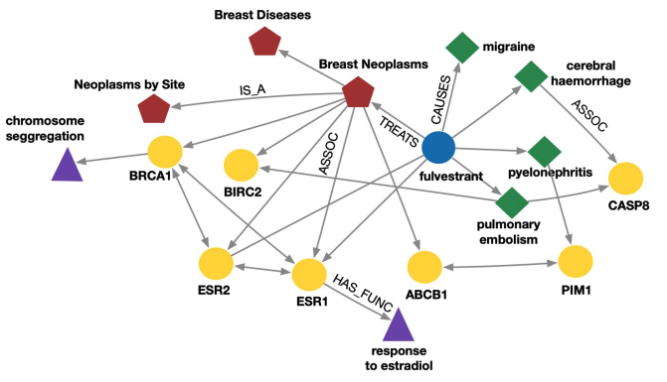
Standard KG completion models fail as foundation models
Structure agnostic shallow encoders learn embeddings for entities and relations
The entity and relation embeddings are the learnable parameters
The structure of the KG is used in the loss function
The KG embeddings are only formed for entities in the single KG
There is no way to transfer knowledge between KGs
What happens if a new entity is added to the KG?
Need to retrain the shallow encoder.
Image credit: Jure Leskovec, http://cs224w.stanford.edu

Slide 29
RGNN models mostly fail

Slide 30
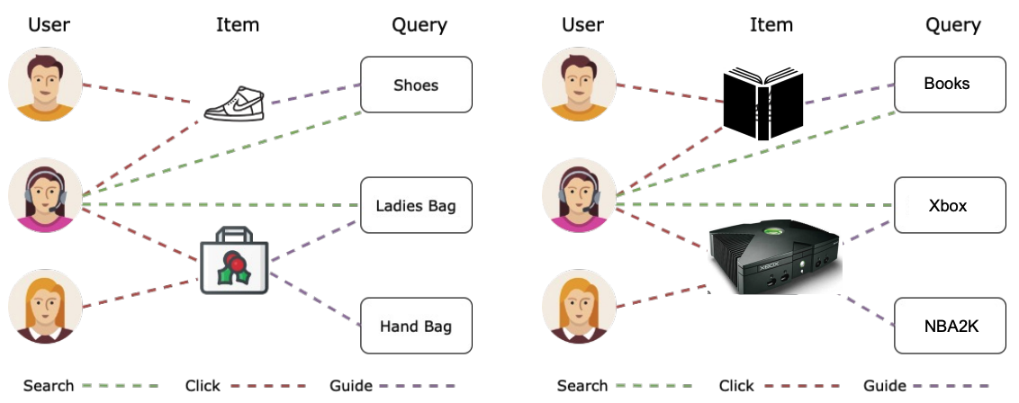
KGs with the same relation types
What if two KGs have the same relation types? (e.g., E-commerce graphs for two different websites)
Can we enable transfer learning between them?
Image credit: Jure Leskovec, http://cs224w.stanford.edu

Slide 31
KGs with the same relation types
What if two KGs have the same relation types? (e.g., imagine E-commerce graphs for two different websites)
Can we enable transfer learning between them?
Observe, a KG is a heterogeneous graph (without node features)
Use a heterogeneous GNN (e.g., RGCN) with randomly initialized feature vectors
Image credit: Jure Leskovec, http://cs224w.stanford.edu

Slide 32
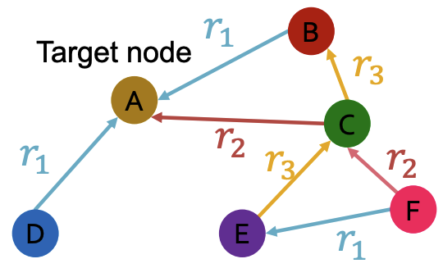
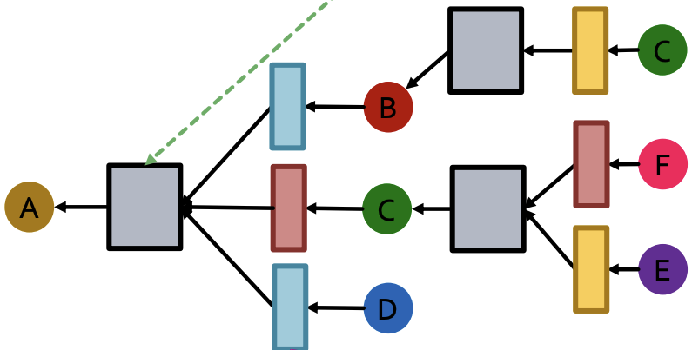
Relational graph convolutional networks (RGCN)
What if the graph has multiple relation types?
Use different neural networks for different relation types
Aggregation
Distinct neural network for each relation type
Image credit: Jure Leskovec, http://cs224w.stanford.edu

Slide 33
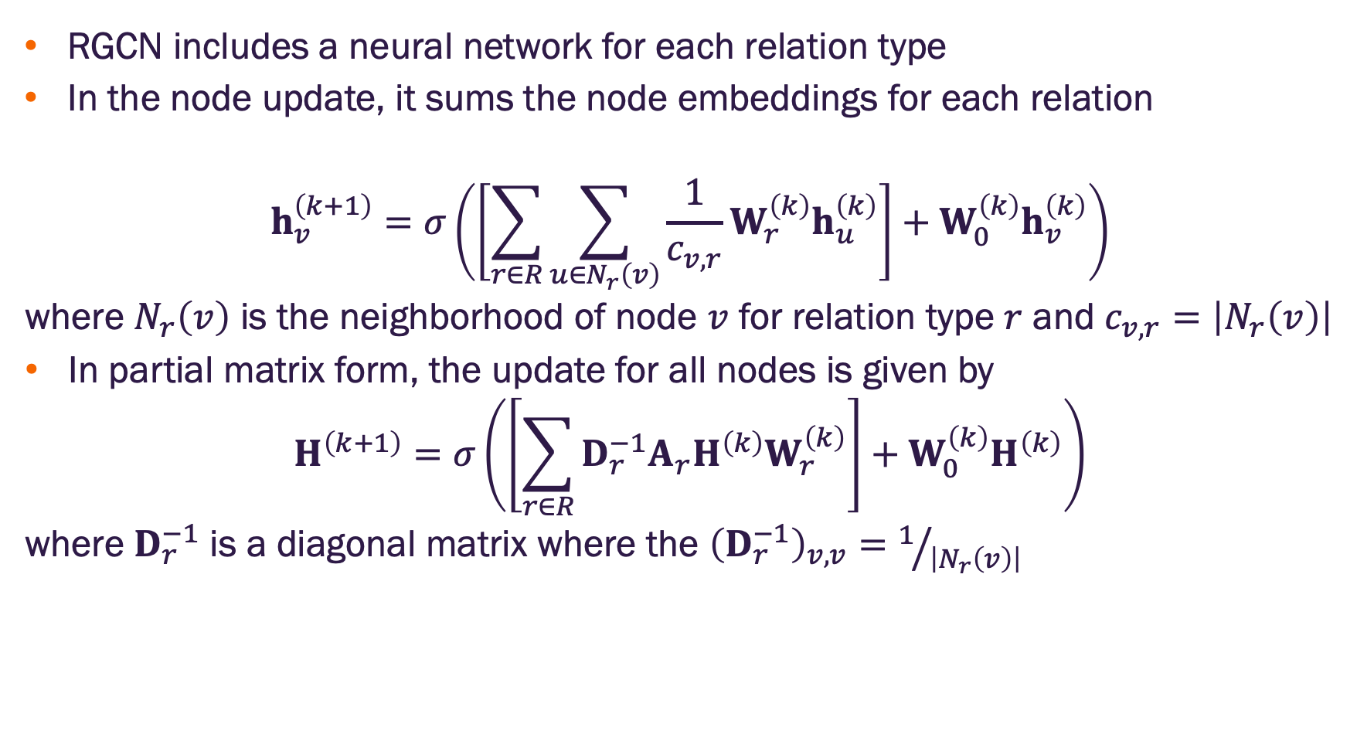
Relational graph convolutional networks (RGCN)
RGCN includes a neural network for each relation type
In the node update, it sums the node embeddings for each relation
$$h_{v}^{\left(k+1\right)}=σ\left(\left[\sum_{r∈R}{\sum_{u∈N_{r}\left(v\right)}{\frac{1}{c_{v,r}}W_{r}^{\left(k\right)}h_{u}^{\left(k\right)}}}\right]+W_{0}^{\left(k\right)}h_{v}^{\left(k\right)}\right)$$
where $N_{r}\left(v\right)$ is the neighborhood of node $v$ for relation type $r$ and $c_{v,r}=\left|N_{r}\left(v\right)\right|$
In partial matrix form, the update for all nodes is given by
$$H^{\left(k+1\right)}=σ\left(\left[\sum_{r∈R}{{D_{r}^{−1}A_{r}H^{\left(k\right)}W}_{r}^{\left(k\right)}}\right]+W_{0}^{\left(k\right)}H^{\left(k\right)}\right)$$
where $D_{r}^{−1}$ is a diagonal matrix where the ${\left(D_{r}^{−1}\right)}_{v,v}=1/{\left|N_{r}\left(v\right)\right|}$

Slide 34
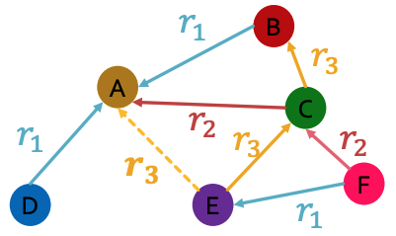
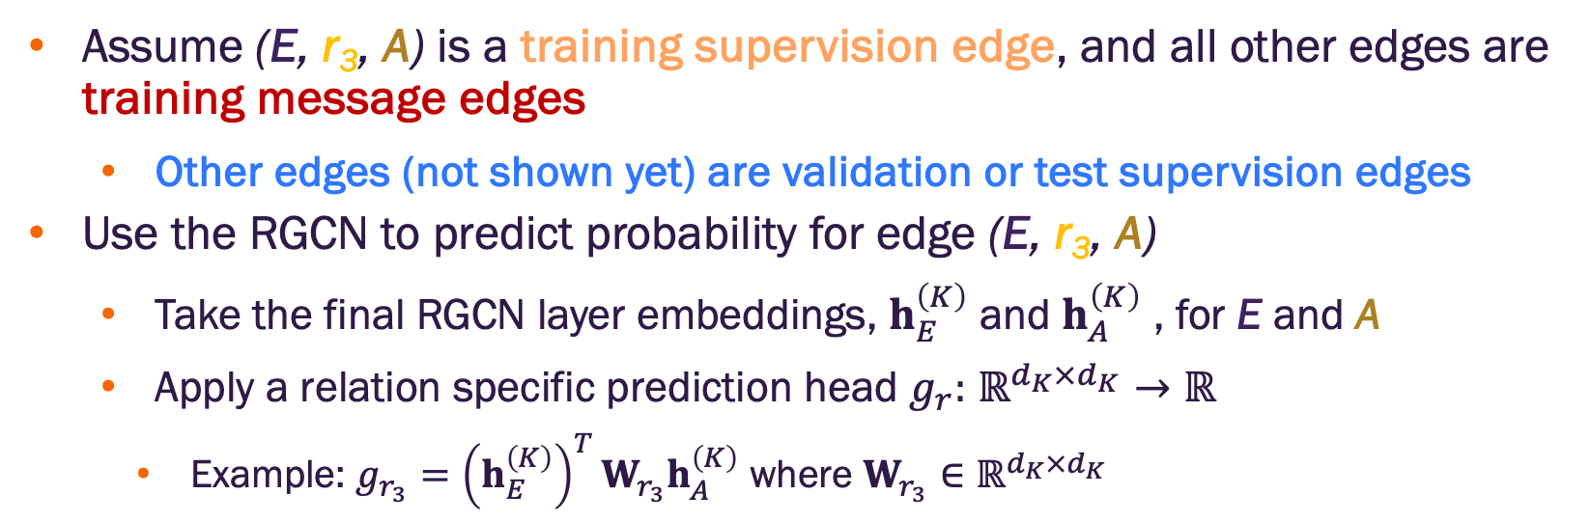
RGCN for edge prediction
Assume (E, r₃, A) is a training supervision edge, and all other edges are training message edges
Other edges (not shown yet) are validation or test supervision edges
Use the RGCN to predict probability for edge (E, r₃, A)
Take the final RGCN layer embeddings, $h_{E}^{\left(K\right)}$ and $h_{A}^{\left(K\right)}$ , for E and A
Apply a relation specific prediction head $g_{r}:$ $ℝ^{d_{K}×d_{K}}→ℝ$
Example: $g_{r_{3}}={\left(h_{E}^{\left(K\right)}\right)}^{T}W_{r_{3}}h_{A}^{\left(K\right)}$ where $W_{r_{3}}∈ℝ^{d_{K}×d_{K}}$
Image credit: Jure Leskovec, http://cs224w.stanford.edu

Slide 35
RGNNs for KGs with the same relation types
RGCN can be used for inductive link prediction across new entities
Example
Training KG contains relation type: (User, Buys, Product)
Second KG also contains relation (User, Buys, Product) with different entities
RGCN cannot predict links for new relation types
Example
Training KG does not contain relation type: (User, Recommends, Product)
Second KG does contain relation type (User, Recommends, Product). The RGCN cannot predict links on this relation.

Slide 36
InGram

Slide 37
Truly foundational
What if I want the model to transfer learning between KGs that have different entities and different relations?

Slide 38
Truly foundational
What if I want the model to transfer learning between KGs that have different entities and different relations?
Training KG
Image credit: Jure Leskovec, http://cs224w.stanford.edu

Slide 39
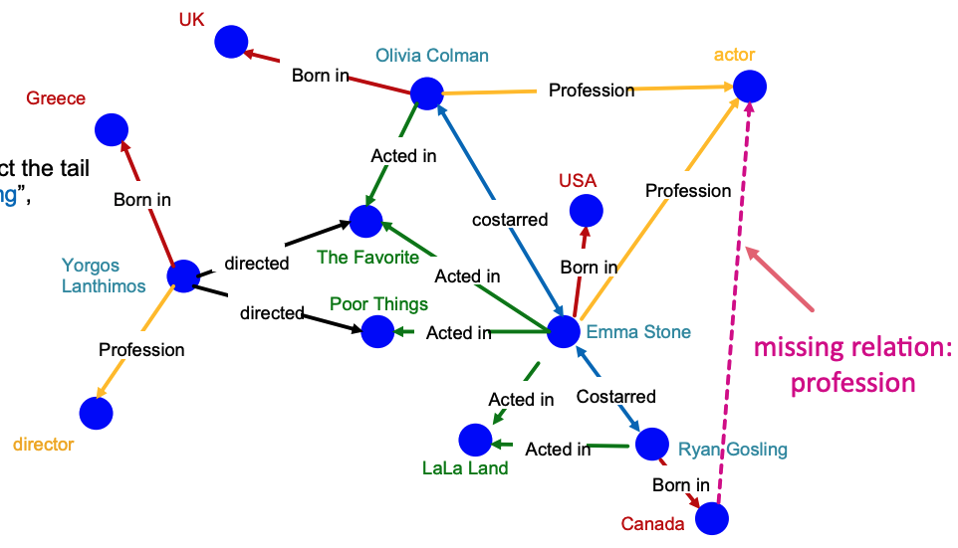
Truly foundational
What if I want the model to transfer learning between KGs that have different entities and different relations?
Task KG
Image credit: Jure Leskovec, http://cs224w.stanford.edu

Slide 40
Truly foundational
What if I want the model to transfer learning between KGs that have different entities and different relations?
We achieved entity equivariance by developing GNNs that learned how to form embeddings based on input graph structure
We need to do something similar for relations
Utilize the structure of relations to let the model learn how to form relation embeddings from an input KG

Slide 41
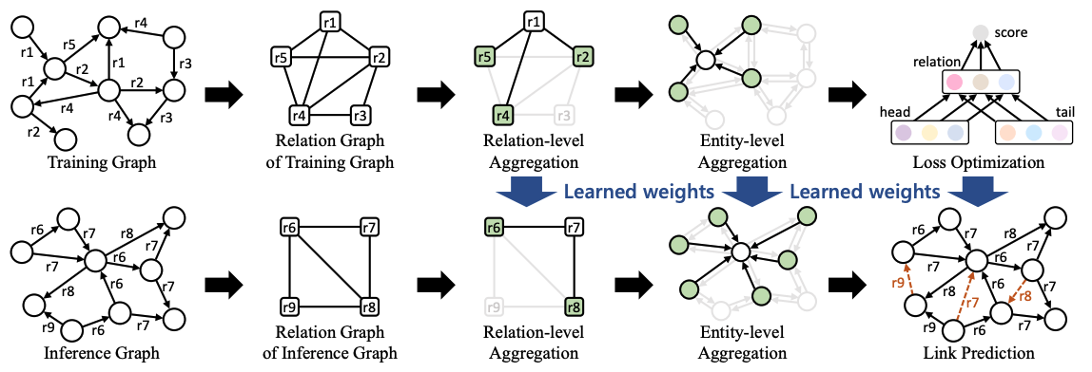
InGram Model
Key idea is to create a relation graph representing the interaction of relations in the input graph
Relation GNN model
Entity
GNN model
Final model
Training
Inference
Image credit: Lee et al. 2023, https://arxiv.org/pdf/2305.19987

Slide 42
InGram Model
Key idea is to create a relation graph representing the interaction of relations in the input graph
How do we construct the relation graph?
How do we form the relation embeddings?
How do we form the entity embeddings?
What is the self-supervised task / loss function?
Image credit: Lee et al. 2023, https://arxiv.org/pdf/2305.19987

Slide 43
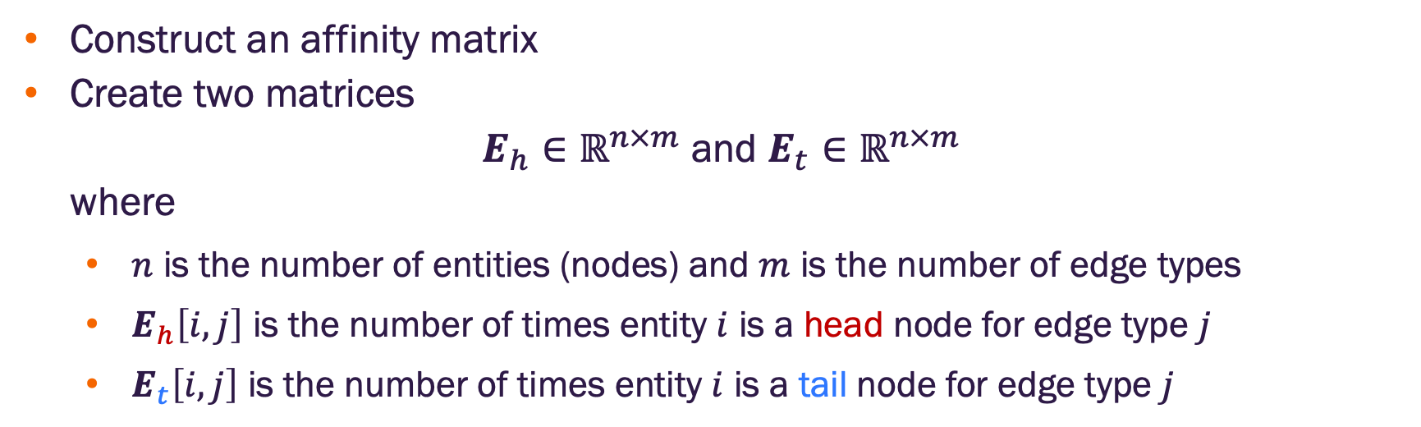
InGram relation graph
Construct an affinity matrix
Create two matrices
$E_{h}∈ℝ^{n×m}$ and $E_{t}∈ℝ^{n×m}$
where
$n$ is the number of entities (nodes) and $m$ is the number of edge types
$E_{h}\left[i,j\right]$ is the number of times entity $i$ is a head node for edge type $j$
$E_{t}\left[i,j\right]$ is the number of times entity $i$ is a tail node for edge type $j$

Slide 44
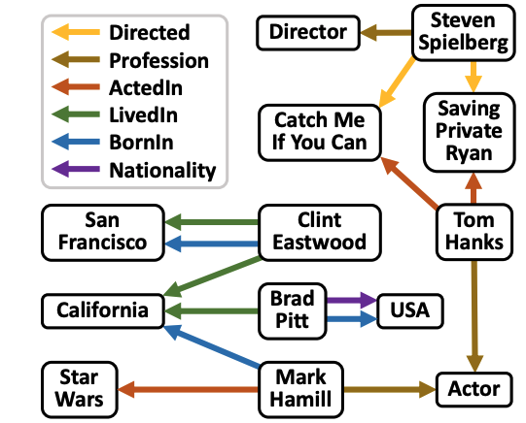
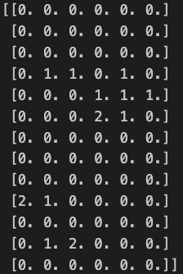
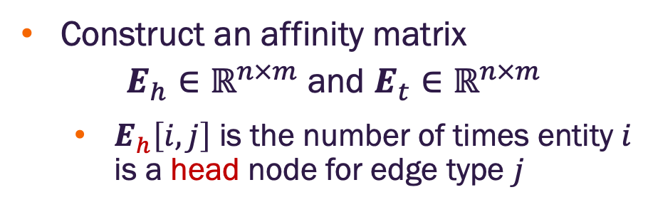
InGram relation graph
https://github.com/masino-teaching/ml4g/blob/main/notebooks/ingram.ipynb
Construct an affinity matrix
$E_{h}∈ℝ^{n×m}$ and $E_{t}∈ℝ^{n×m}$
$E_{h}\left[i,j\right]$ is the number of times entity $i$ is a head node for edge type $j$
0
1
2
3
4
5
San Francisco
California
Star Wars
Hamill
Pitt
Eastwood
Catch Me
Director
USA
Spielberg
Private Ryan
Hanks
Actor
Image credit: Lee et al. 2023, https://arxiv.org/pdf/2305.19987

Slide 45
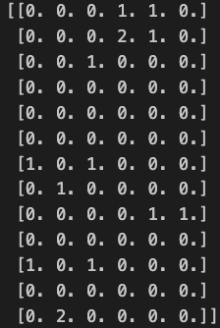
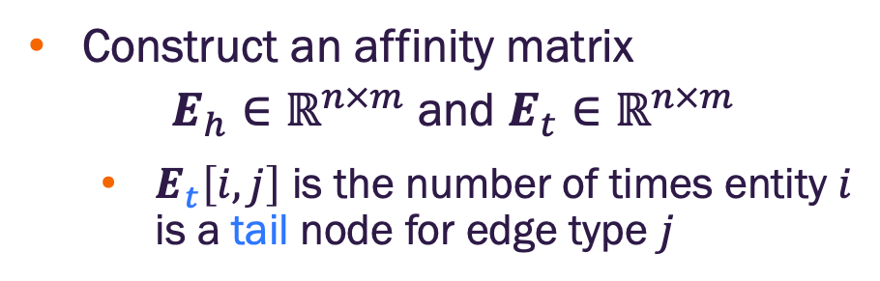
InGram relation graph
https://github.com/masino-teaching/ml4g/blob/main/notebooks/ingram.ipynb
Construct an affinity matrix
$E_{h}∈ℝ^{n×m}$ and $E_{t}∈ℝ^{n×m}$
$E_{t}\left[i,j\right]$ is the number of times entity $i$ is a tail node for edge type $j$
0
1
2
3
4
5
San Francisco
California
Star Wars
Hamill
Pitt
Eastwood
Catch Me
Director
USA
Spielberg
Private Ryan
Hanks
Actor
Image credit: Lee et al. 2023, https://arxiv.org/pdf/2305.19987

Slide 46
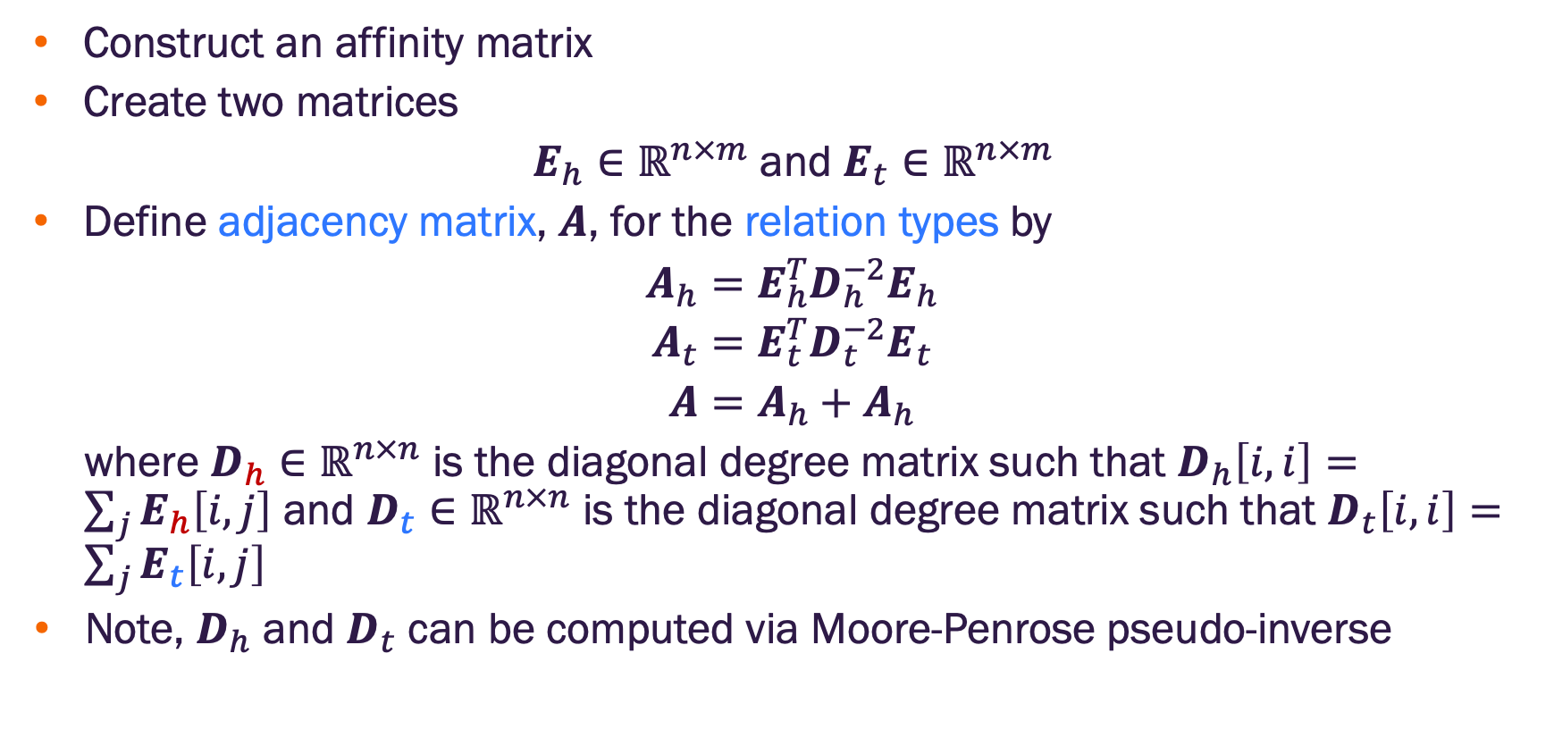
InGram relation graph
Construct an affinity matrix
Create two matrices
$E_{h}∈ℝ^{n×m}$ and $E_{t}∈ℝ^{n×m}$
Define adjacency matrix, $A$, for the relation types by
$$A_{h}=E_{h}^{T}D_{h}^{−2}E_{h}$$
$$A_{t}=E_{t}^{T}D_{t}^{−2}E_{t}$$
$$A=A_{h}+A_{h}$$
where $D_{h}∈ℝ^{n×n}$ is the diagonal degree matrix such that $D_{h}\left[i,i\right]=\sum_{j}{E_{h}\left[i,j\right]}$ and $D_{t}∈ℝ^{n×n}$ is the diagonal degree matrix such that $D_{t}\left[i,i\right]=\sum_{j}{E_{t}\left[i,j\right]}$
Note, $D_{h}$ and $D_{t}$ can be computed via Moore-Penrose pseudo-inverse
https://github.com/masino-teaching/ml4g/blob/main/notebooks/ingram.ipynb

Slide 47
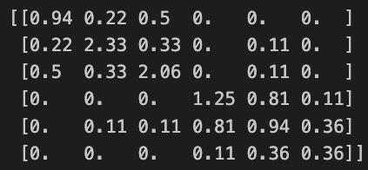
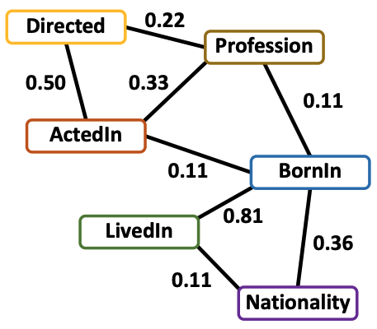
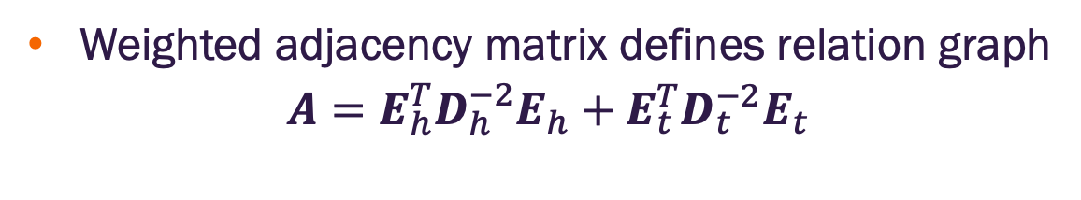
InGram relation graph
https://github.com/masino-teaching/ml4g/blob/main/notebooks/ingram.ipynb
Weighted adjacency matrix defines relation graph
$$A=E_{h}^{T}D_{h}^{−2}E_{h}+E_{t}^{T}D_{t}^{−2}E_{t}$$
0
1
2
3
4
5
Relation adjacency matrix
KG
Relation Graph
Image credit: Lee et al. 2023, https://arxiv.org/pdf/2305.19987

Slide 48
InGram Model
Key idea is to create a relation graph representing the interaction of relations in the input graph
✔️How do we construct the relation graph?
How do we form the relation embeddings?
How do we form the entity embeddings?
What is the self-supervised task / loss function?
Image credit: Lee et al. 2023, https://arxiv.org/pdf/2305.19987

Slide 49
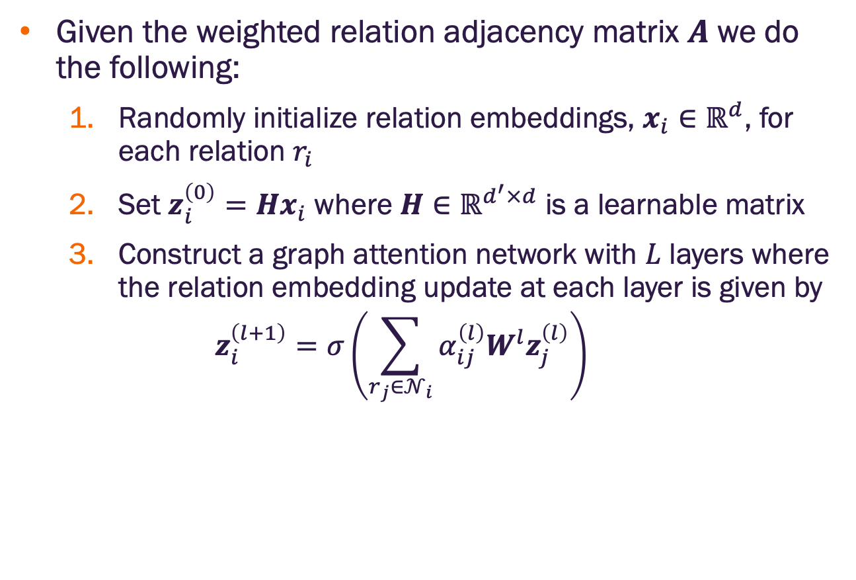
InGram relation embeddings
Given the weighted relation adjacency matrix $A$ we do the following:
Randomly initialize relation embeddings, $x_{i}{∈ℝ}^{d}$, for each relation $r_{i}$
Set $z_{i}^{\left(0\right)}=Hx_{i}$ where $H∈ℝ^{d^{′}×d}$ is a learnable matrix
Construct a graph attention network with $L$ layers where the relation embedding update at each layer is given by
$$z_{i}^{\left(l+1\right)}=σ\left(\sum_{r_{j}∈𝒩_{i}}{α_{ij}^{\left(l\right)}W^{l}z_{j}^{\left(l\right)}}\right)$$

Slide 50
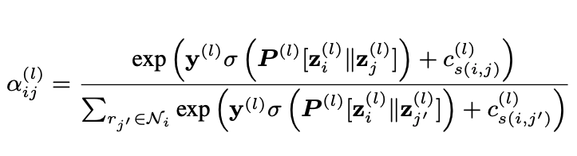
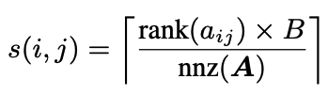
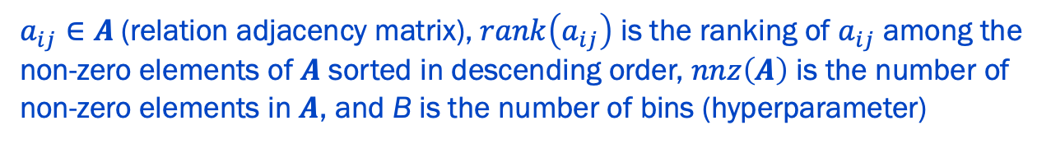
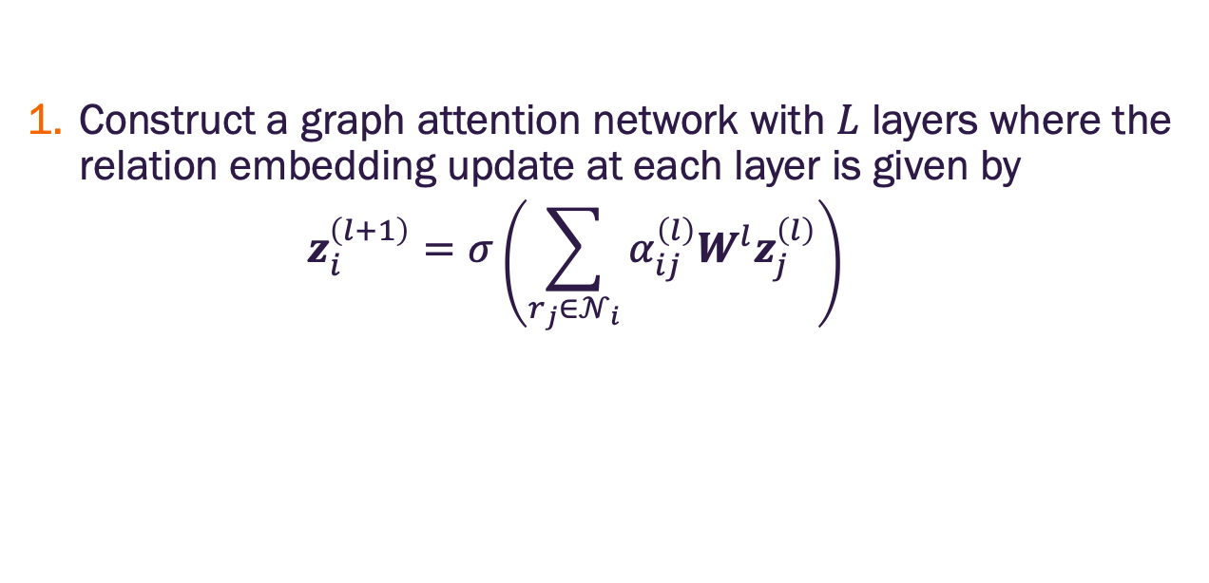
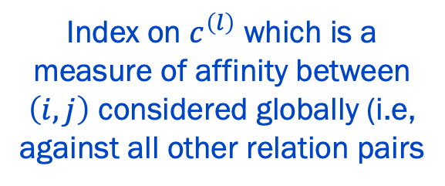
InGram relation embeddings
Construct a graph attention network with $L$ layers where the relation embedding update at each layer is given by
$$z_{i}^{\left(l+1\right)}=σ\left(\sum_{r_{j}∈𝒩_{i}}{α_{ij}^{\left(l\right)}W^{l}z_{j}^{\left(l\right)}}\right)$$
Learnable parameters
Index on $c^{\left(l\right)}$ which is a measure of affinity between $\left(i,j\right)$ considered globally (i.e, against all other relation pairs
$a_{ij}∈A$(relation adjacency matrix), $rank\left(a_{ij}\right)$ is the ranking of $a_{ij}$ among the non-zero elements of $A$ sorted in descending order, $nnz\left(A\right)$ is the number of non-zero elements in $A$, and B is the number of bins (hyperparameter)

Slide 51
InGram Model
Key idea is to create a relation graph representing the interaction of relations in the input graph
✔️How do we construct the relation graph?
✔️ How do we form the relation embeddings?
How do we form the entity embeddings?
What is the self-supervised task / loss function?
Image credit: Lee et al. 2023, https://arxiv.org/pdf/2305.19987

Slide 52
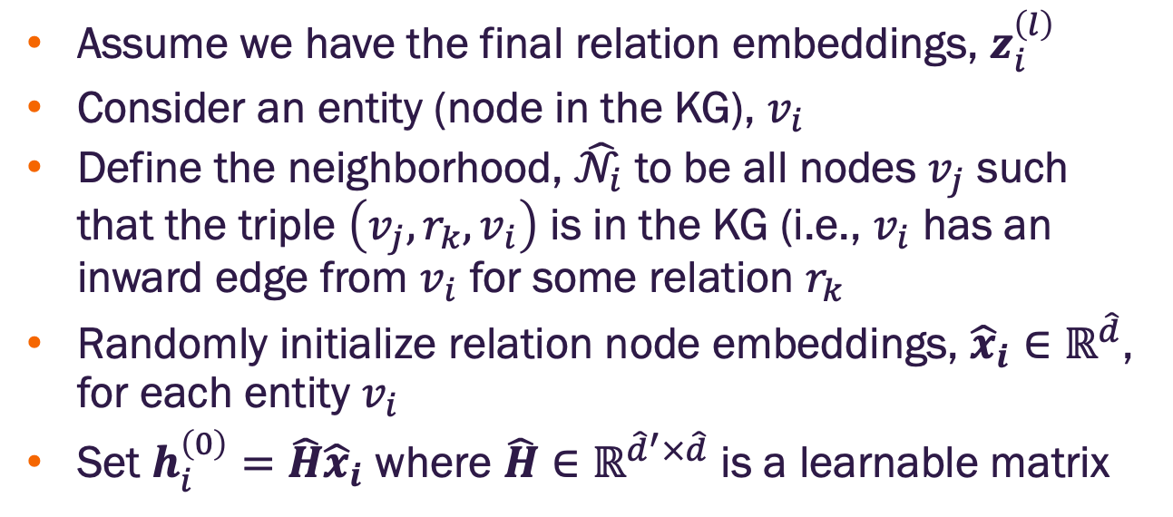
InGram entity embeddings
Assume we have the final relation embeddings, $z_{i}^{\left(l\right)}$
Consider an entity (node in the KG), $v_{i}$
Define the neighborhood, ${\hat{𝒩}}_{i}$ to be all nodes $v_{j}$ such that the triple $\left(v_{j}, r_{k},v_{i}\right)$ is in the KG (i.e., $v_{i}$ has an inward edge from $v_{i}$ for some relation $r_{k}$
Randomly initialize relation node embeddings, ${\hat{x}}_{i}{∈ℝ}^{\hat{d}}$, for each entity $v_{i}$
Set $h_{i}^{\left(0\right)}={\hat{H}\hat{x}}_{i}$ where $\hat{H}∈ℝ^{{\hat{d}}^{′}×\hat{d}}$ is a learnable matrix

Slide 53
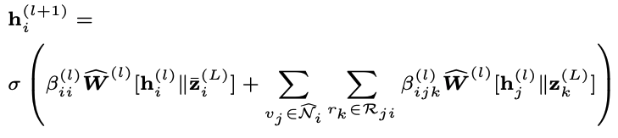



InGram entity embeddings
Set $h_{i}^{\left(0\right)}={\hat{H}\hat{x}}_{i}$ where $\hat{H}∈ℝ^{{\hat{d}}^{′}×\hat{d}}$ is a learnable matrix
Construct a graph attention network with $L$ layers where the entity embedding update at each layer is given by
Learnable matrix
Self loop
Neighbor aggregation with attention
Mean of the relation embeddings for the relations incident to $v_{i}$

Slide 54



InGram entity embeddings
Neighbor aggregation with attention
Learnable parameters
Final relation embeddings from relation graph GNN

Slide 55
InGram Model
Key idea is to create a relation graph representing the interaction of relations in the input graph
✔️How do we construct the relation graph?
✔️ How do we form the relation embeddings?
✔️ How do we form the entity embeddings?
What is the self-supervised task / loss function?
Image credit: Lee et al. 2023, https://arxiv.org/pdf/2305.19987

Slide 56


InGram prediction head
Learnable parameters
Final model outputs
Relation $r_{k}$ embedding $z_{k}=Mz_{k}^{\left(L\right)}$
Entity $v_{i}$ embedding $h_{i}=\hat{M}h_{i}^{\left(\hat{L}\right)}$
Scoring function for tail completion
$$f\left(v_{i},r_{k},v_{j}\right)=h_{i}^{T}diag\left(\overline{W}z_{k}\right)h_{j}$$
Contrastive margin loss

Slide 57
InGram
So what did this get us?
GNN learns how to form entity embeddings from graph structure → inductive on entities
GNN learns how to form relation embeddings from graph structure → inductive on relations
Can be used for inductive link prediction on new entities and new relations
It is a method that can yield foundation models
Limitations
Use of degree statistics for relation graph weights causes InGram to be distributionally double equivariant – i.e., over many permutations the average relation embeddings are double equivariant, but any given permutation may not be
See Zhou 2025 for more - https://arxiv.org/pdf/2302.01313

Slide 58


